Slide 1
Noteline

Slide 2
Application de note
Objectives :
Création des notes
Possibilités de modification de notes
Groupement de notes par catégories ou par favorite
Recherche de notes

Slide 3









Technologies utilisées dans le projet:

Slide 4
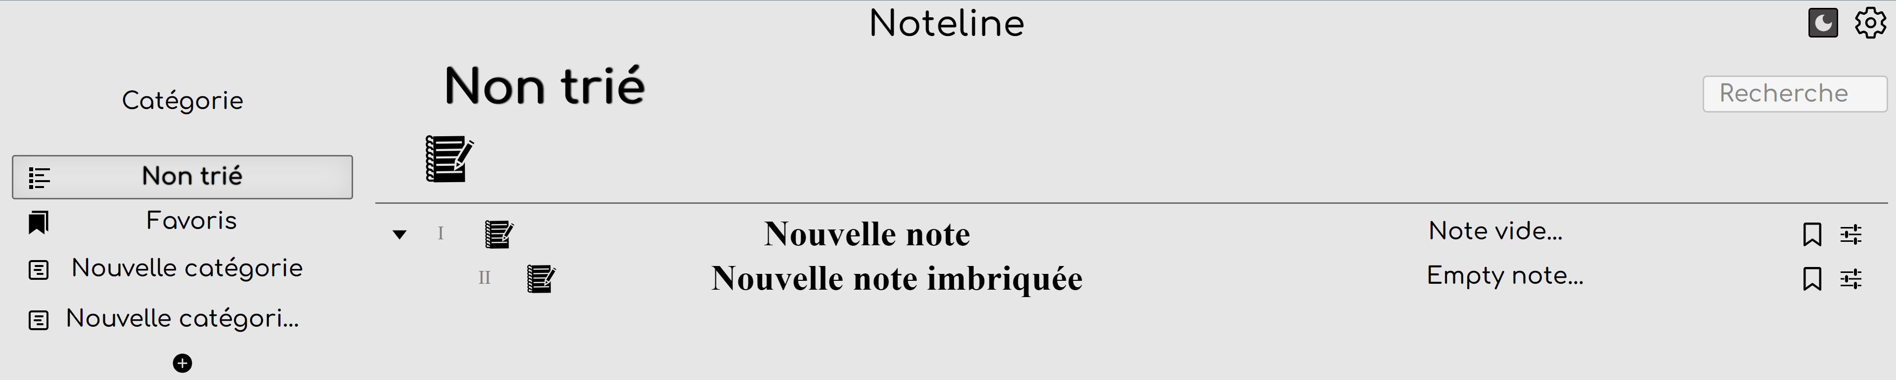
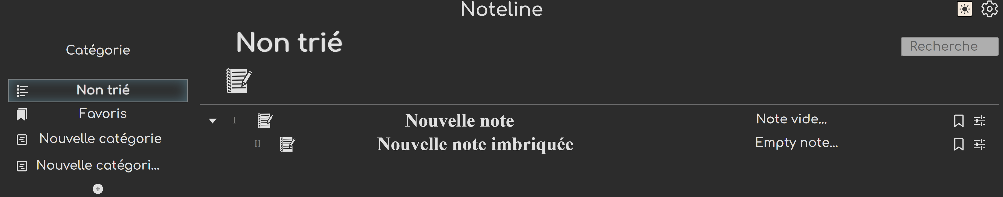
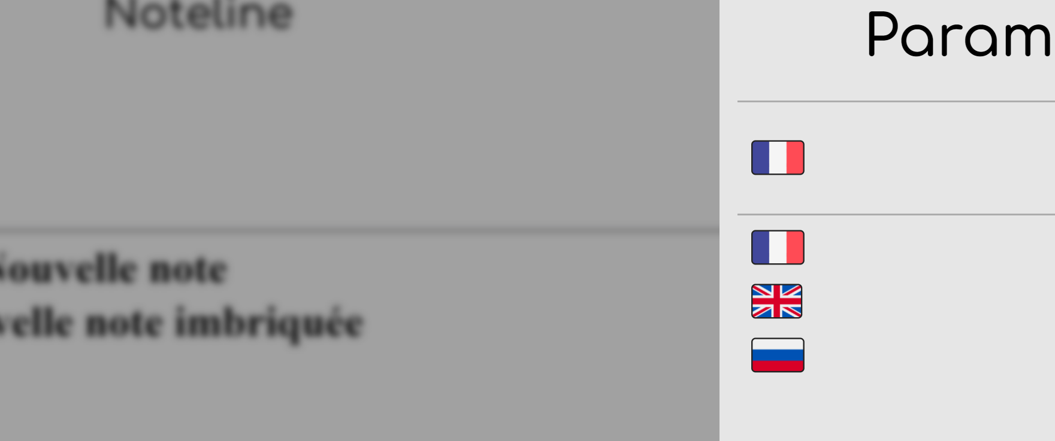



UI
npm react-icons
Localisation i18

Slide 5


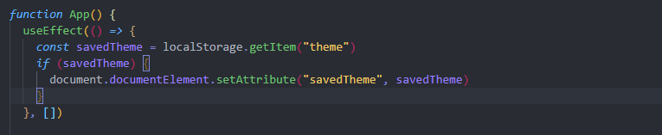
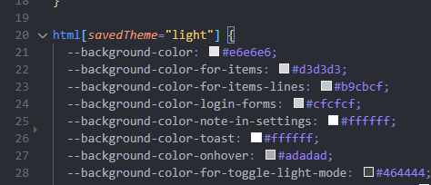
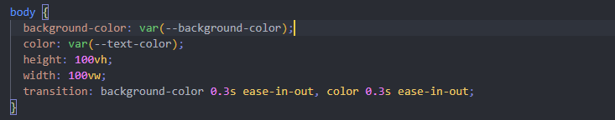
UI color mode

Slide 6
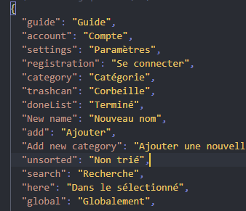

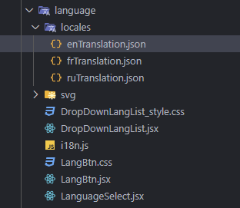
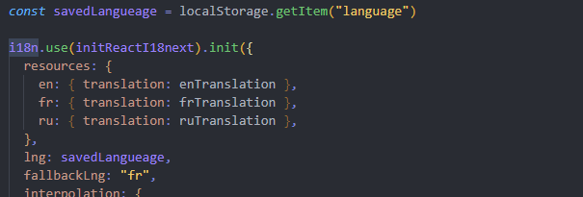
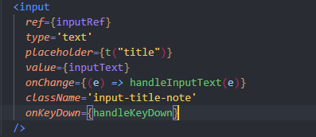
npm i18n
UI
i18n internationalization

Slide 7
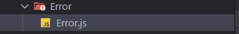
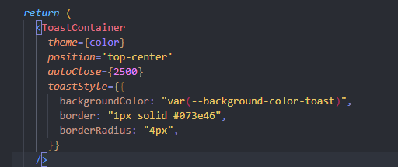
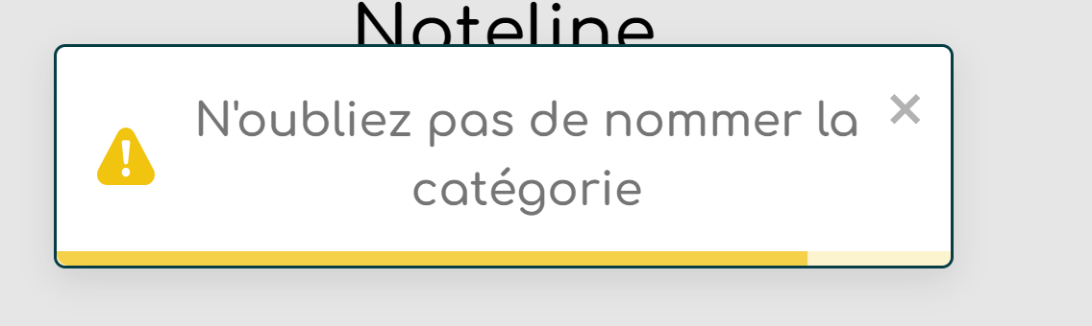
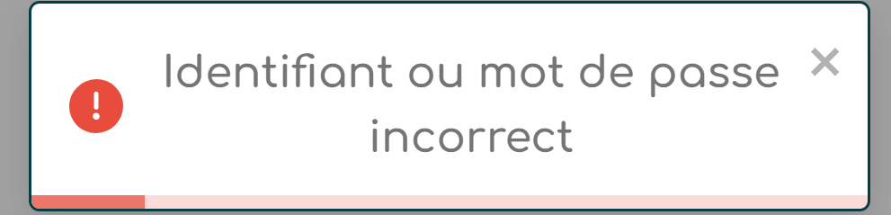
UI Toasts
npm react-toastify

Slide 8
Structure

Slide 9
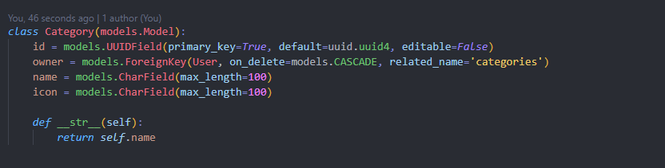
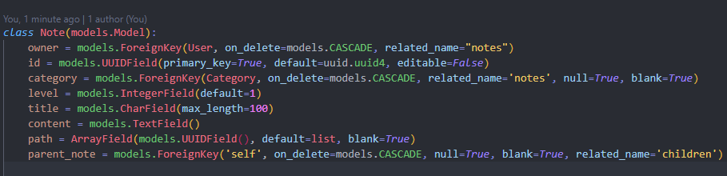
Backend
Models

Slide 10
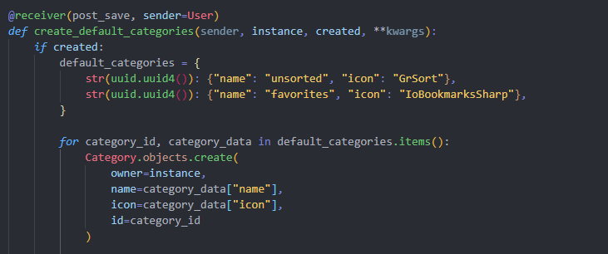
Backend
Models
Créez automatiquement deux catégories standard pour un nouvel utilisateur

Slide 11
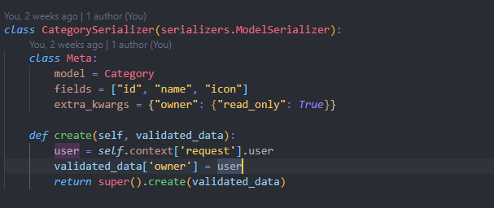
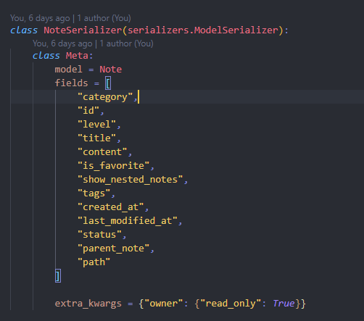
Backend
Models
Serializer

Slide 12
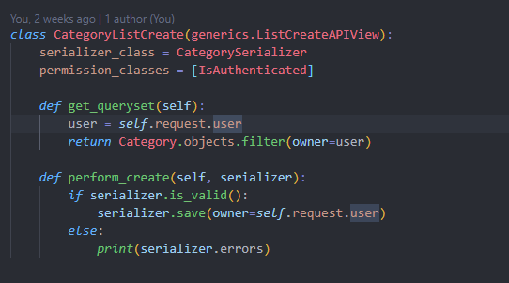
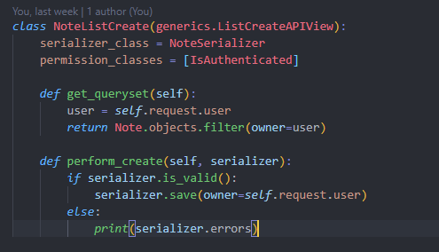
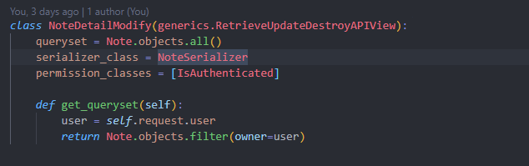
Backend
Models
Serializer
Views

Slide 13
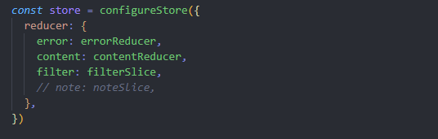
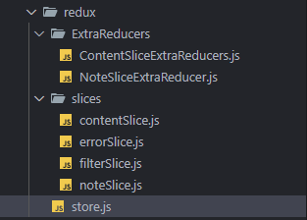
Logic
Redux-store
Error
Filter
Content

Slide 14
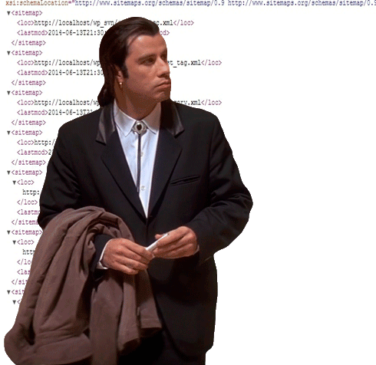
Logic

Slide 15
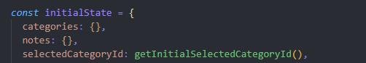
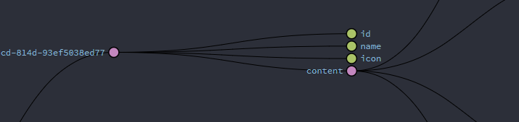
Redux
Structure de Content-Slice
categories: {id:{}, id:{},…}
notes: {id:{}, id:{},…}
*category

Slide 16
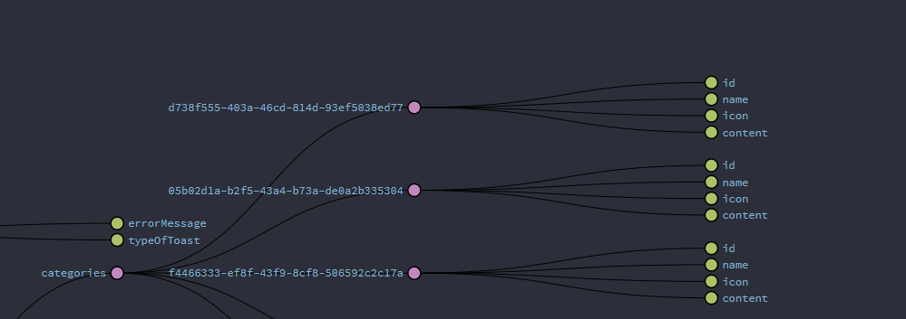

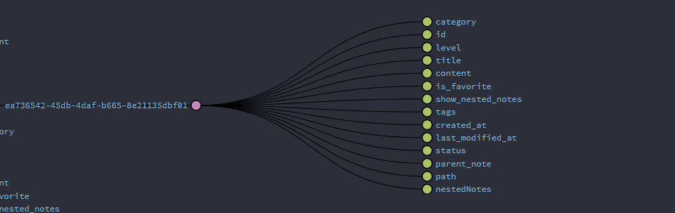

Structure des element
npm uuid
categories
uuid : {key:valeur,…}
{ }
note

Slide 17
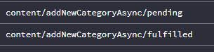
Create
export const addNewCategoryAsync = createAsyncThunk(
"content/addNewCategoryAsync",
async (name) => {
const id = uuidv4()
const response = await api.post("/api/categories/", {
id,
icon: "default",
name,
})
return response.data
}
)
const handleAddNewCategory = () => {
if (inputText) {
dispatch(addNewCategoryAsync(inputText))
path("categories/", views.CategoryListCreate.as_view(), name="category-list"),
.addCase(addNewCategoryAsync.fulfilled, (state, action) => {
const { id, name, icon } = action.payload
state.categories[id] = { id, name, icon, content: {} }
})

Slide 18
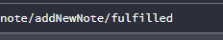
Note
Create
dispatch(
addNewNoteAsync({
title: text,
category: choosenCategoryId,
parentId,
level: ++level,
path: path,
parent_note: parentId,
content: t("empty note"),
})
)
<div
className={`notes-nested ${areNestedNotesVisible ? "expanded" : ""}`}
>
{isAddingNewNestedNote && thatNoteSelected ? (
<NewNote
onClose={onClose}
parentId={id}
level={level}
path={[...path, id]} // ADDING A NEW PATH TO NOTE PATH DIRECTION
/>
) : null}
export const addNewNoteAsync = createAsyncThunk(
"note/addNewNote",
async ({ title, category, parent_note, level, path, content }) => {
const id = uuidv4()
const response = await api.post("/api/notes/", {
id,
title,
level,
content,
category,
parent_note,
path,
parent_note,
})
return response.data
}
)
path("notes/", views.NoteListCreate.as_view(), name="note-list"),

Slide 19
Note
Create
.addCase(addNewNoteAsync.fulfilled, (state, action) => {
const parentNote = findNestedObject(
state.categories[category].content,
path
parentNote[id] = {
category,
id,
level,
title,
content,
is_favorite,
show_nested_notes,
tags,
created_at,
last_modified_at,
status,
parent_note,
path,
nestedNotes: {},
}
}
const findNestedObject = (obj, path) => {
return path.reduce((acc, key) => acc && acc[key].nestedNotes, obj)
}

Slide 20
Read
useEffect(() => {
dispatch(fetchNotes())
}, [dispatch])
export const fetchNotes = createAsyncThunk("note/fetchNotes", async () => {
const response = await api.get("api/notes/")
return response.data
})
path("notes/", views.NoteListCreate.as_view(), name="note-list"),

Slide 21
Read
const findNestedObject = (obj, path) => {
return path.reduce((acc, key) => acc && acc[key].nestedNotes, obj)
}
.addCase(fetchNotes.fulfilled, (state, action) => { const notes = action.payload
notes.sort((a, b) => a.level - b.level)
const updatedNotes = notes.reduce((acc, note) => {
acc[note.id] = { ...note, nestedNotes: {} }
state.notes[note.id] = note if (note.is_favorite) {
state.categories[state.favoriteCategoryId].content[note.id] = {
...note,
nestedNotes: null,
}
} if (note.path.length === 0) {
const category = state.categories[note.category]
if (category) {
category.content[note.id] = acc[note.id]
}
} else {
const parentNotes = findNestedObject(
state.categories[note.category].content
note.path
)
if (parentNotes) {
parentNotes[note.id] = acc[note.id]
}
} return acc
}, {})
})

Slide 22
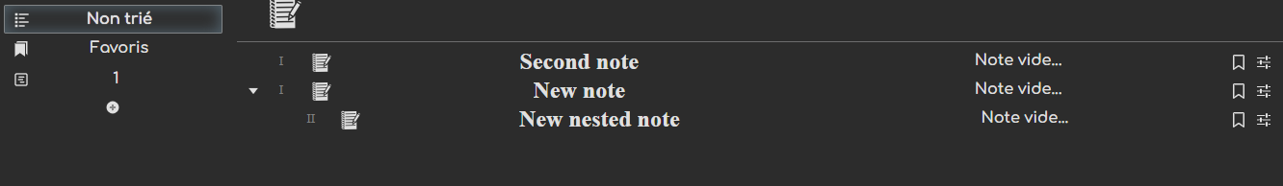
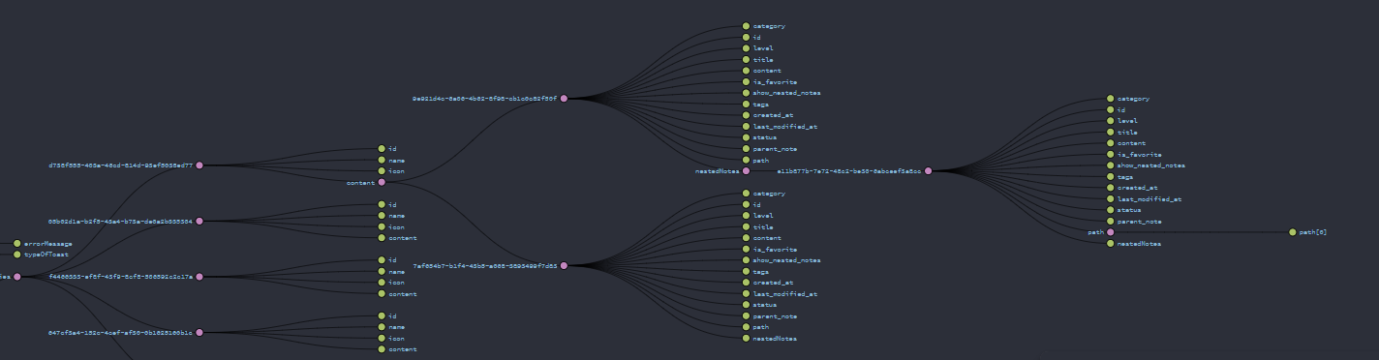
Read

Slide 23
Modify
export const modifyContentNoteAsync = createAsyncThunk(
"note/modifyContentNoteAsync",
async ({ id, content, path }) => {
const response = await api.patch(`/api/notes/${id}/`, {
content,
})
return response.data
}
)
parentNote = state.categories[state.notes[id].category].content
parentNote[id].title = title

Slide 24
Delete
export const deleteNoteAsync = createAsyncThunk(
"note/deleteNoteAsync",
async ({ id, path }) => {
const response = await api.delete(`/api/notes/${id}/`)
return { id, path }
}
)
let parentNote
if (path.length > 0) {
parentNote = findNestedObject(
state.categories[state.notes[id].category].content,
path
)
} else {
parentNote = state.categories[state.notes[id].category].content
}
delete parentNote[id]

Slide 25
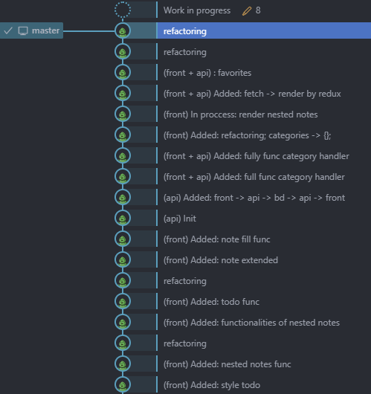
*git

Slide 26


Principaux problèmes lors de la création d'un projet:
Fausse estimation du temps de réalisation
Répartition en sous-tâches

